Slide 1
CAPSTONE PROJECT NETFLIX DATA ANALYSIS
Presented By:
K.M.S.MOHAMED ABUBACKER SIDDIQ
REG.NO: 951821105003
9518-NELLAI COLLEGE OF ENGINEERING
DEPARTMENT OF ELECTRICAL AND ELECTRONICS ENGINEERING

Slide 2
OUTLINE
Problem statement
System development approach
Algorithm and Deployment
Result
Conclusion
References

Slide 3
PROBLEM STATEMENT
We analyze a lot of data and models from netflix because this platform has consistently focused on changing business needs by shifting its business model from on demand DVD movie rental and now focusing a lot about the production of their original shows. In this project I will take a look at some very important models of Netflix data to understand what’s best of their business.

Slide 4
PROBLEM STATEMENT
Some of the most important tasks that I can analyze from Netflix data are:
1.Understand what content is available
2. Understand the similarities between the content
3. Understand the network between actors and director
4. What exactly Netflix is focusing on and sentiment analysis of content available on Netflix.

Slide 5
SYSTEM APPROACH
System Requirement:
Hardware
A computer with sufficient processing power, preferably with multiple core.
Adequate RAM to handle the size of the dataset and computational requirements
2. Software
An operating system compatible with the required machine learning libraries.(windows)

Slide 6
Library Requirements:
Data processing and Analysis
- Pandas:For data manipulation and analysis.
- Numpy:For numerical operations on data.
Data Visualization:
- Matplotlib and Seaborn:For creating visualizations to understand data patterns.
- Plotly or Bokeh:Interactive visualization libraries for more complex visualizations.

Slide 7
ALGORITHM
Data Collection:
Gather historical netflix movie data, including information about director and actor ,movie releasing years, movie ratings, movie rating person counts.
Data Cleaning:
Handle missing values, out liters, and any inconsistencies in the dataset.
Covert categorical variables into numerical representations through encoding techniques.
Feature Engineering:
Create new features or modify exiting ones based on knowledge
Extract meaningful information from data variables.

Slide 8
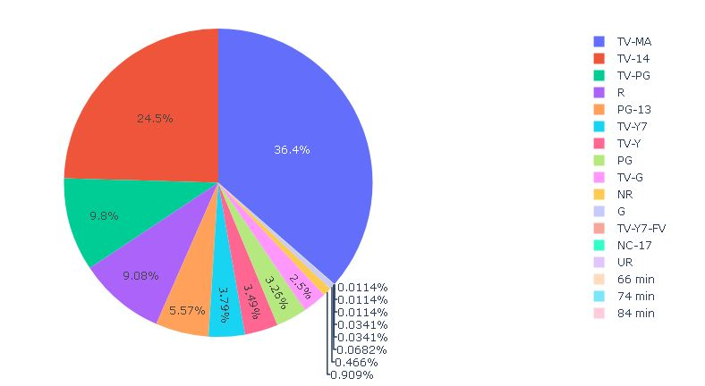
RESULT

Slide 9
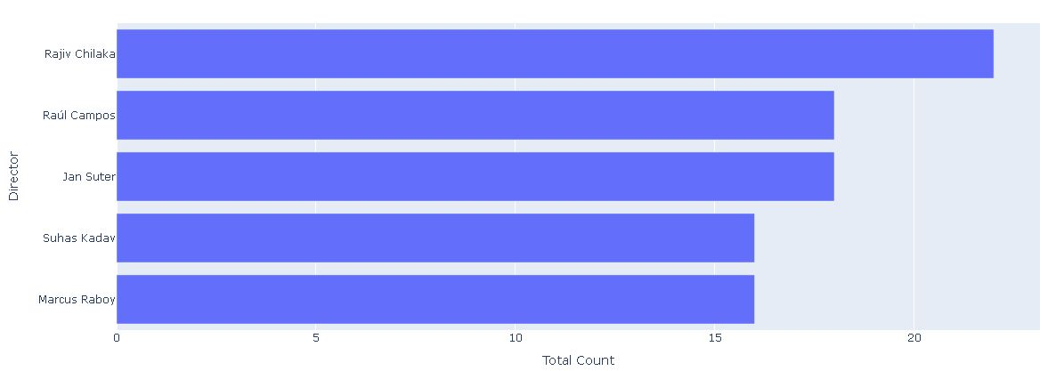
Result….

Slide 10
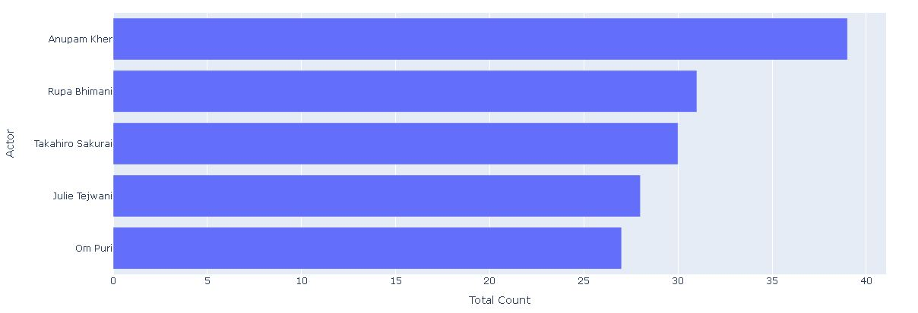
Result….

Slide 11
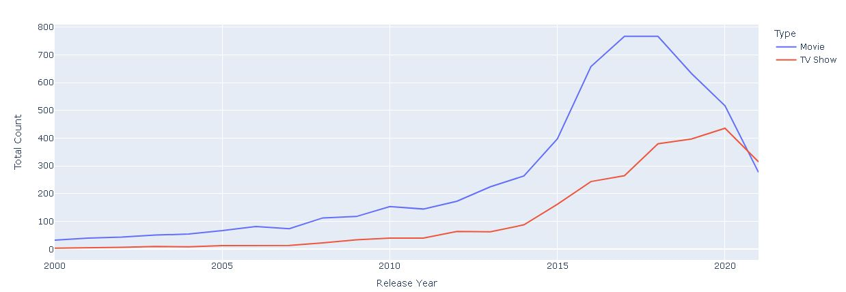
Result….

Slide 12
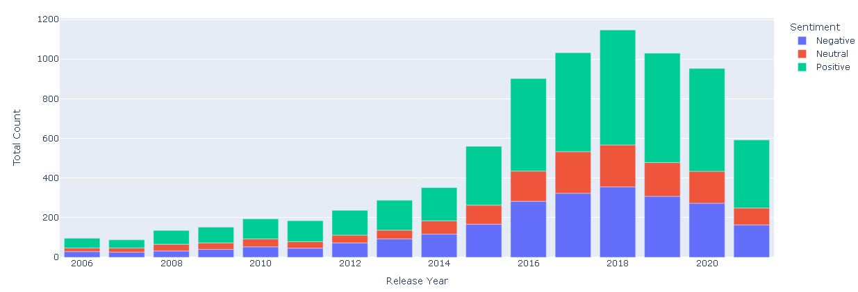
Result….

Slide 13
CONCLUSION
I collected the data set from kaggle website,
Netflix movie data are analyzed successfully using google colab and the results are shown above.

Slide 14
References
1. https://www.kaggle.com/datasets
2.https://pandas.pydata.org/pandas-docs/stable/user guide/index.html

